Slide 1
RICO

Slide 2
Organized Crime
How would you characterize Organized Crime?

Slide 3
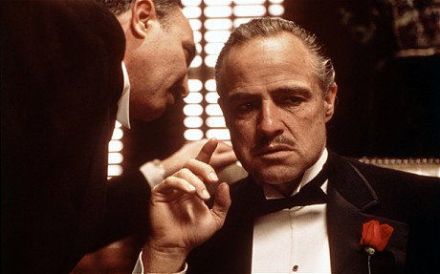

Slide 4
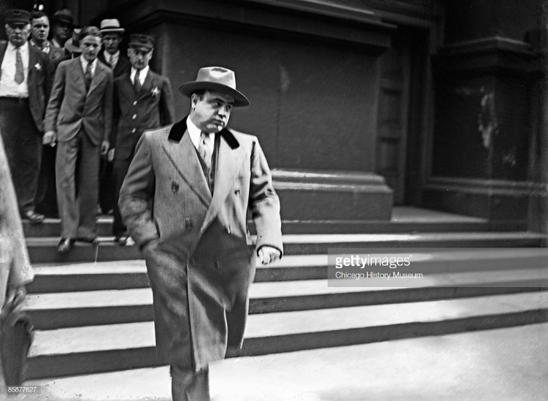
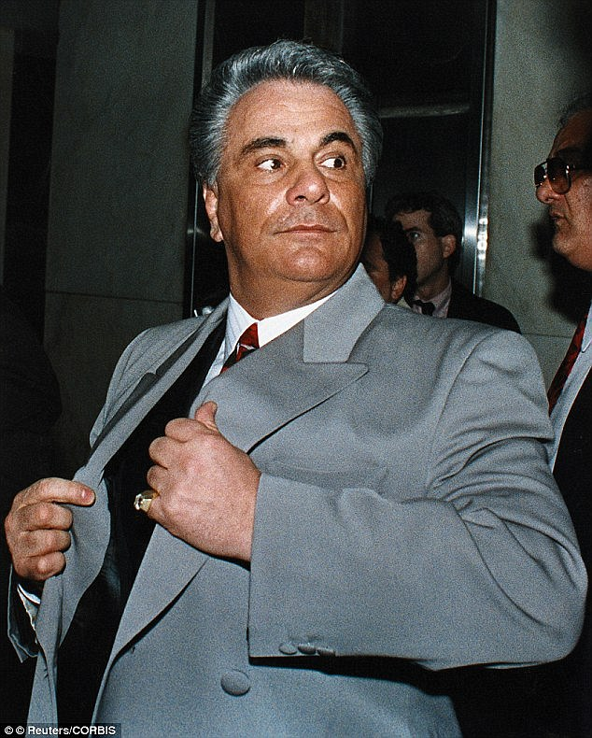

Slide 5
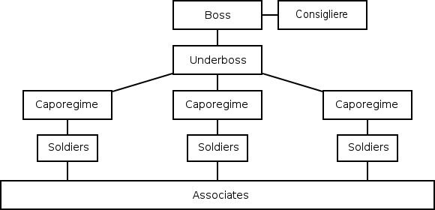

Slide 6
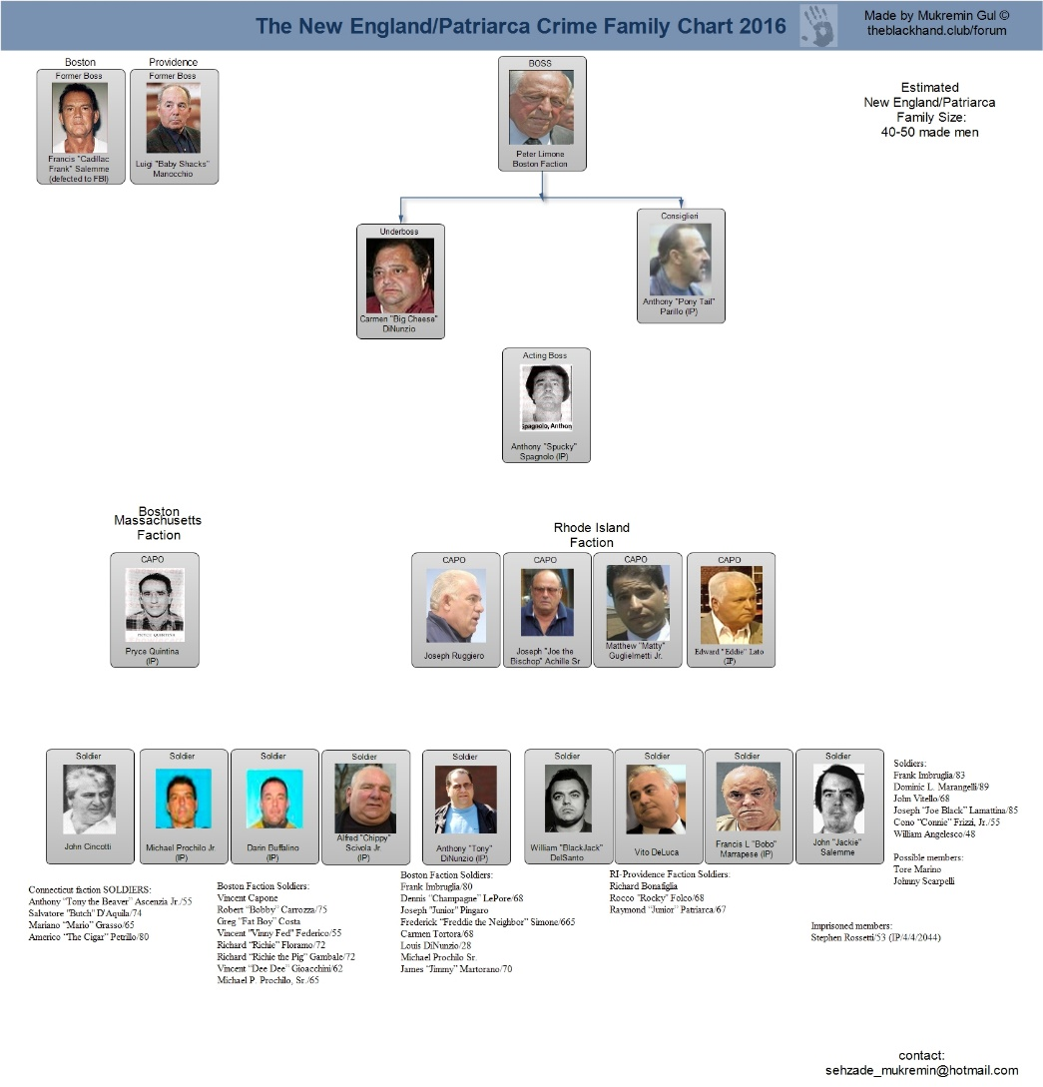

Slide 7
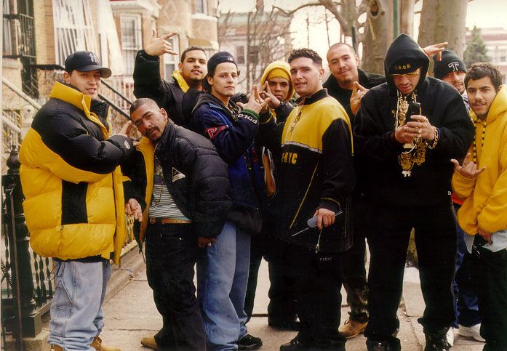

Slide 8
If a murder was committed on the far side of town and the "Capo" didn't pull the trigger, but it was done to protect the territory of a 'cleaning service" that the mob runs through another division, but it originated out of another business, and he didn't actually give the command, and the hit-man wasn't paid by him directly, and.......

Slide 9
RICO - Introduction
RICO stands for “ Racketeer Influenced and Corrupt Organizations Act”
RICO provides for extended criminal and civil penalties for acts performed as part of an ongoing criminal organization
RICO was enacted in 1970. The main purpose was to go after criminal organizations (e.g. “mafia”)
Each individual is criminally culpable for ALL of the illegal activity of the enterprise

Slide 10
RICO – Concept
RICO focuses specifically on an activity called ”racketeering”, and it allows the leaders of a syndicate to be tried for the crimes which they ordered others to do or assisted them.
Racketeering is the act of offering of a dishonest service (a "racket") to solve a problem that wouldn't otherwise exist without the enterprise offering the service.

Slide 11
RICO - Elements
RICO requires:
An enterprise or organization . . .
Conducting a pattern . . .
of racketeering activity.

Slide 12
RICO - Enterprise
An ‘enterprise’ is defined in 18 U.S.C section 1961 (4) to include “any individual, partnership, corporation, association, or other legal entity, and any union or group of individuals associated in fact although not a legal entity”.
What is Enterprise?
any group with members who are associated in a relationship in order to achieve a common purpose, provided the relationship lasts long enough to allow them to pursue that purpose.
In the terminology of RICO law, such groups are known as “association-in-fact” enterprises.

Slide 13
RICO - Pattern
A ‘pattern of racketeering activity’ requires at least two acts of racketeering activity within a 10 year period. Acts of racketeering are specific defined offenses (predicate offenses) drawn from a list of 35 crimes—
Any violation of state statutes against gambling, murder, kidnapping, extortion, arson, robbery, bribery;
Any act of bribery, counterfeiting, theft, embezzlement, fraud, dealing in obscene matter, obstruction of justice, slavery, gambling, commission of murder-for-hire, and many other offenses covered under the Federal criminal code (Title 18);
Bankruptcy fraud or securities fraud;
Drug trafficking;
Criminal copyright infringement;
Money laundering; mail fraud; and wire fraud
To be a pattern the activities must be “related and continuous”
Relatedness will be established if the crimes have similar characteristics such as the same perpetrators, victims, and methods of commission.
The criminal acts must be related to the RICO enterprise

Slide 14
RICO - Penalties
RICO is a distinct criminal offense (even though it involves other criminal activity)
Each RICO conviction comes with up to 20 year prison sentence
Each RICO violation must be based on one of the 35 predicate charges (racketeering activity)
In addition, RICO provides for civil forfeiture procedures to start before criminal conviction.
“freezing assets” of the defendant
Upon conviction, the defendant’s interest in the organization automatically forfeited.

Slide 15


Slide 16
FIFA Case
In 2015, the U.S. indicted 14 people who were members of FIFA or related organizations (e.g. CONCACAF)
The people were involved a scheme to take bribes for television contracts.
Cannot be charged with bribery because no government officials involved
Instead U.S. is using RICO

Slide 17
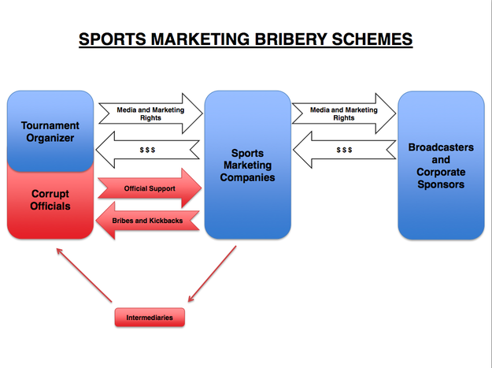
FIFA Case

Slide 18
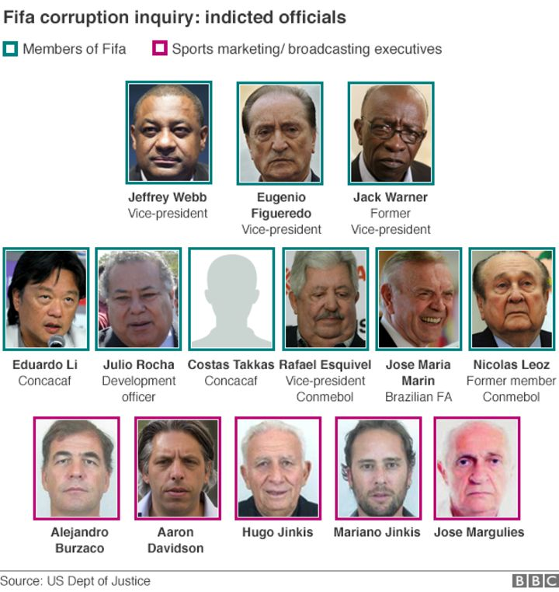
FIFA – RICO Case

Slide 19
FIFA Case
However the corruption scheme occurred OUTSIDE the United States
How can U.S. law be applies extraterritorially?
If the criminal activity affected interstate commerce
Money Laundering
Wire Fraud
What is the enterprise?
The Federation Internationale de Football Association ("FIFA") and its six constituent continental confederations - . . .­ together with affiliated regional federations, national member associations, and sports marketing companies, collectively constituted an "enterprise," as defined in Title 18, United States Code, Section 1961(4), that is, a group of legal entities associated in fact (hereinafter the "enterprise").
Who is the Victim?

Slide 20
Internet Crimes?
https://www.wired.com/2013/12/rico/

Slide 21
References
https://www.justice.gov/opa/file/450211/download

